Slide 1

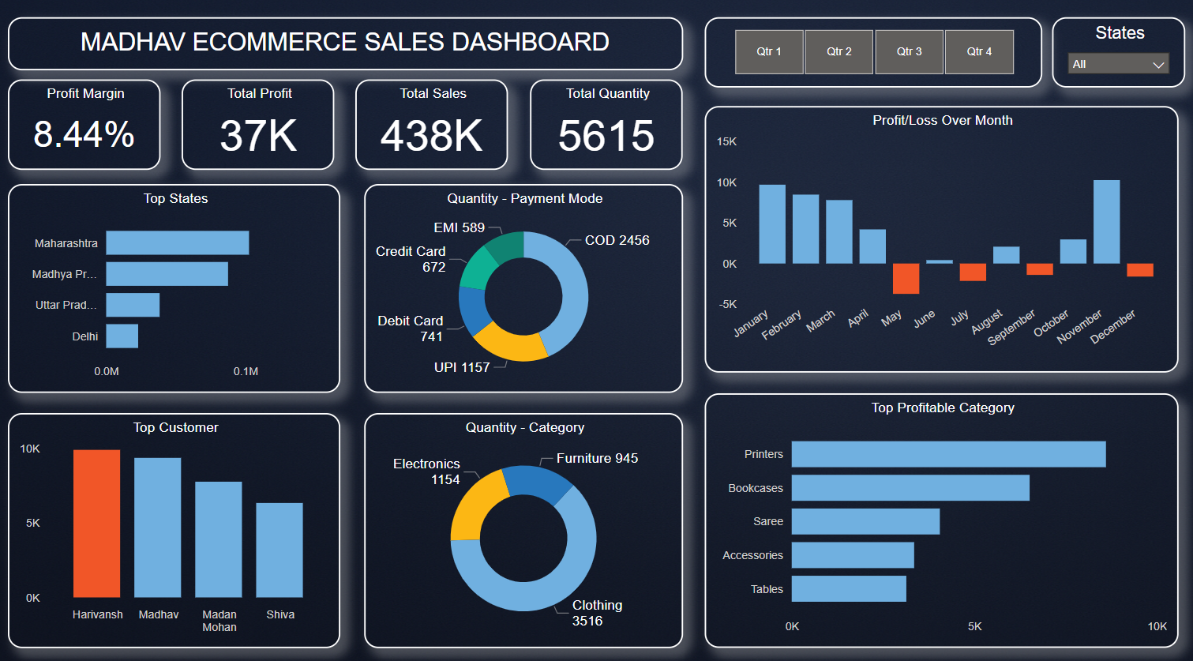
Sales Dashboard Overview
Analyzing key metrics to drive sales success
Abhishek Singhal
Sales Analyst
June 16, 2025

Slide 2

Madhav E-Commerce Sales Insights
In this presentation, we analyze key e-commerce sales metrics including total sales, profit margins, top-performing categories, payment trends, and customer behaviors. These insights are drawn from real-time sales data and are aimed at identifying growth drivers and operational opportunities.

Slide 3






Key Trends in Sales Performance
Our sales dashboard highlights strong product demand (5615 units sold), ₹37K profit, and top contributions from categories like clothing and electronics. Areas for improvement include profit dips in Q2 and optimizing high-volume but low-margin products.

Slide 4


Conversion Rate
Customers like Harivansh, Madhav, Madan Mohan, and Shiva account for the highest sales.
Sales Metrics Overview
Order Value Snapshot
The average revenue per order is ₹78, based on ₹438K in total sales and 5615 total units — reflecting small, consistent transactions.
Payment Preferences
Understanding the four key metrics driving our sales
Most customers prefer Cash on Delivery (2456 orders) and UPI (1157 orders), revealing trends in trust and convenience.
Sales Growth Trend
Strong growth in Q1 and Q4, with a dip in mid-year. Total sales reached ₹438K across 2023.

Slide 5
Sales Growth Comparison for Q1 and Q2
These statistics highlight key performance trends between Q1's strong start and Q2's mid-year sales challenges.
Sales according to Q1
Sales according to Q2
10.5%
2.3%
Sales and profit were at their peak during January–March, reflecting strong performance and customer demand.
Profit dipped sharply in May and June, indicating operational or seasonal challenges.

Slide 6


Sales Performance Comparison
Metric | Q1 (Jan–Mar) | Q2 (Apr–Jun) | Q3 (Jul–Sep)
Profit Performance | Strong months with consistent profit | Profit dip, especially in May and June | Recovery begins; September sees profit improvement
Sales Volume | Driven by Clothing and Electronics | Dip in volume; seasonal drop | Stabilizes and trends upward
Profit Margin | Approx. 10.5% | Approx. 2.3% | Rebounding; around 6–7% estimate based on recovery

Slide 7


Get in Touch with Us
Email
abhishek.singhal0610@gmail.com
Social Media
www.linkedin.com/in/-abhishek
Call us
9997701135

